Slide 1


Control Flow
Chris Piech
CS106A, Stanford University

Slide 2
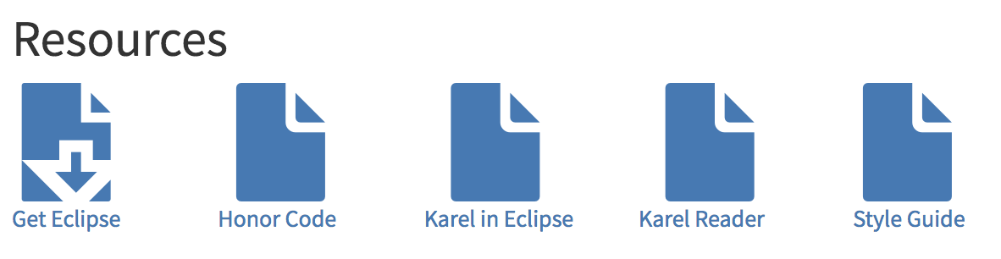
Assignment 1

Slide 3
Install Eclipse
Special Eclipse office hours
LAIR 7-9pm

Slide 4
Honor Code

Slide 5
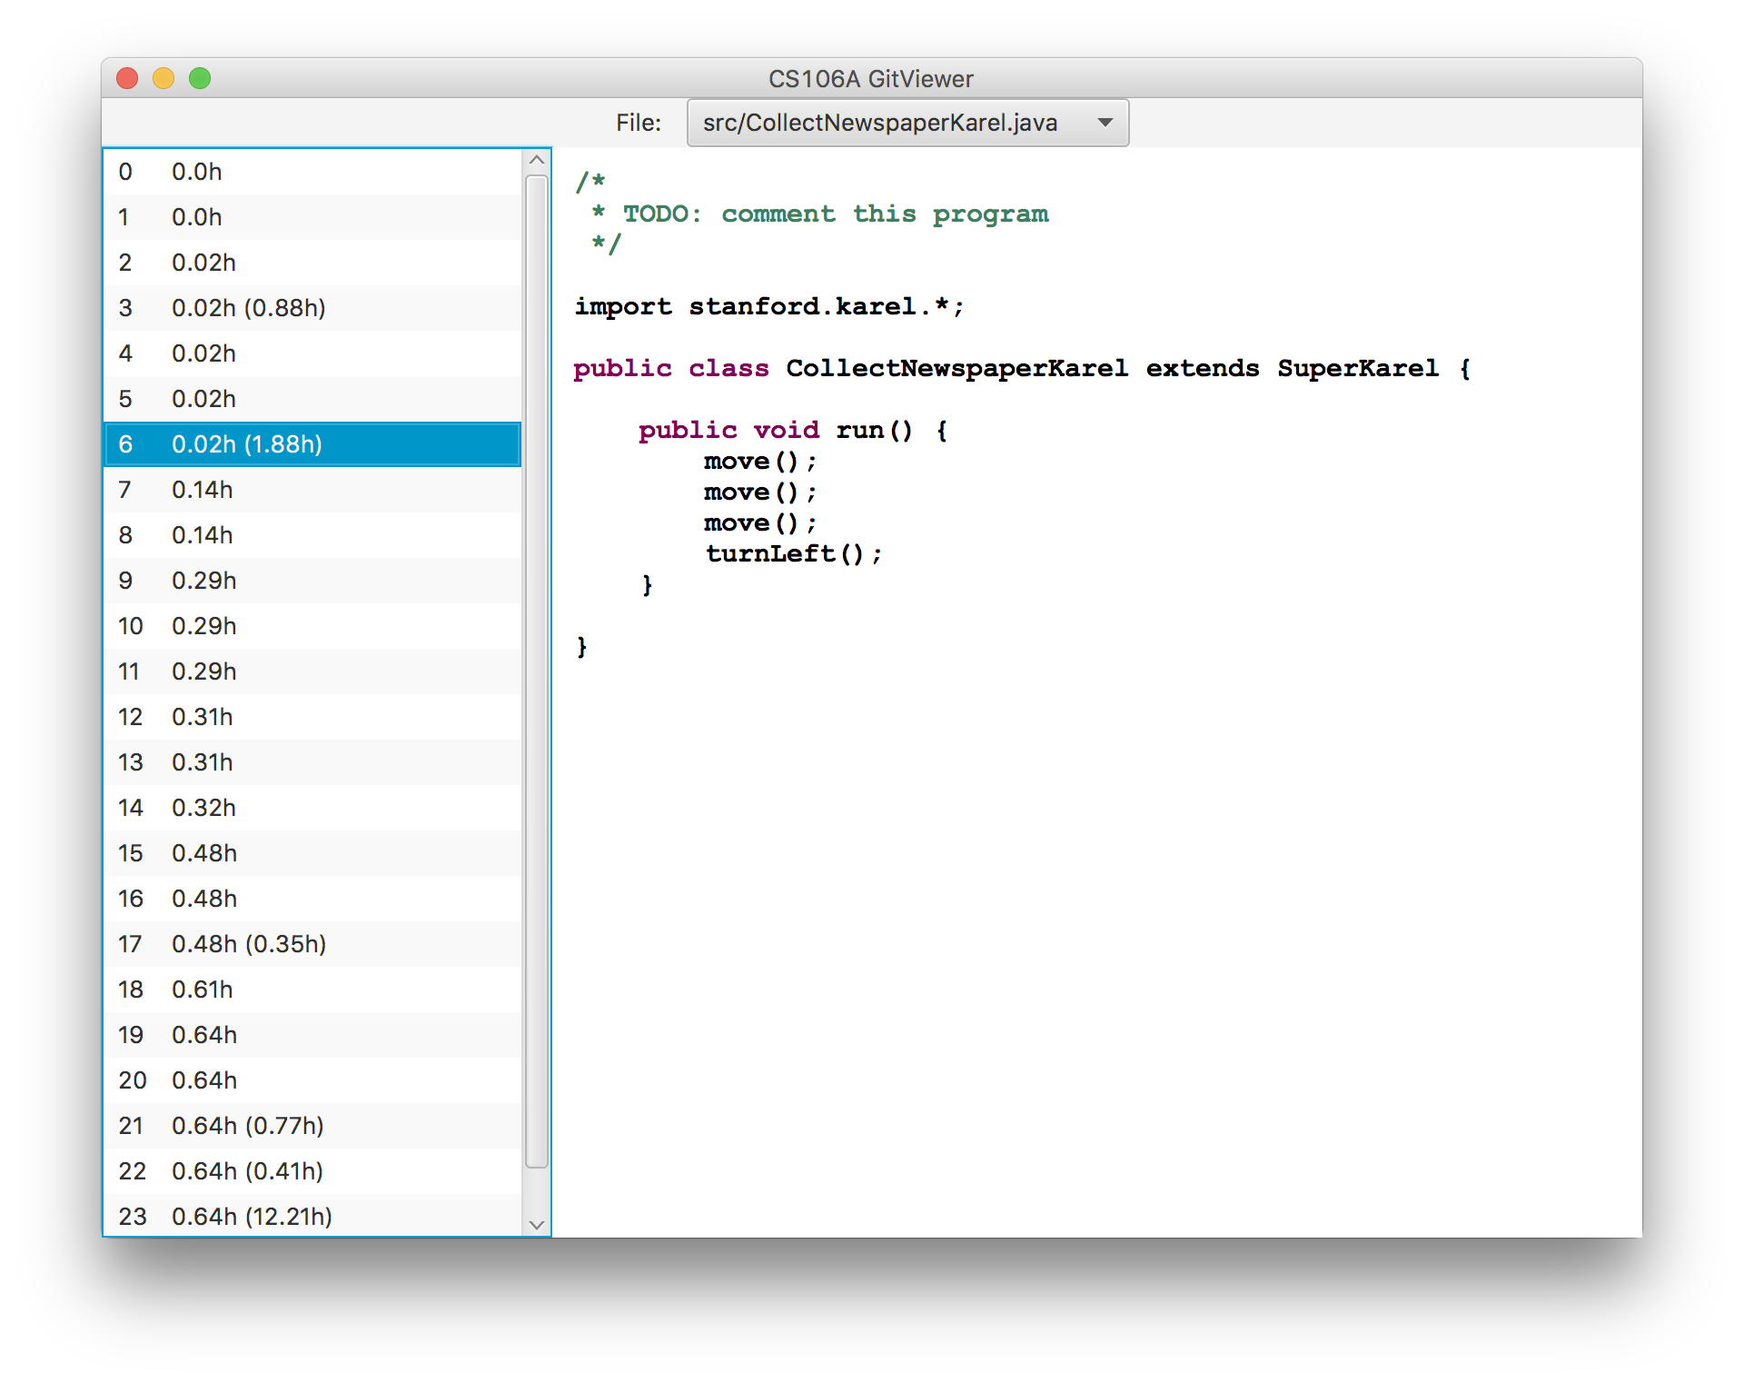
Feedback on Progress

Slide 6

CS106A

Slide 7


Karel the Robot
s
* While Karel is in Java, when you program your Karel assignment we ask that you stick to the concepts in the course reader
Notes:
Tomorrow you will learn that Karel is actually a very gentle introduction to programming

Slide 8


First Challenge
3
+
+
+
+
2
+
+
+
+
1
+
+
+
+
1
2
3
4

Slide 9
Anatomy of a Program
import stanford.karel.*;
public class OurKarelProgram extends Karel {
public void run() {
move();
pickBeeper();
move();
turnLeft();
move();
turnRight();
move();
putBeeper();
move();
}
private void turnRight() {
turnLeft();
turnLeft();
turnLeft();
}
}
This is the program's source code

Slide 10
Anatomy of a Program
import stanford.karel.*;
public class OurKarelProgram extends Karel {
public void run() {
move();
pickBeeper();
move();
turnLeft();
move();
turnRight();
move();
putBeeper();
move();
}
private void turnRight() {
turnLeft();
turnLeft();
turnLeft();
}
}
This piece of the program's source code is called a method.

Slide 11
Anatomy of a Program
import stanford.karel.*;
public class OurKarelProgram extends Karel {
public void run() {
move();
pickBeeper();
move();
turnLeft();
move();
turnRight();
move();
putBeeper();
move();
}
private void turnRight() {
turnLeft();
turnLeft();
turnLeft();
}
}
x
This line of code gives the name of the method
(here, run)

Slide 12
Anatomy of a Program
import stanford.karel.*;
public class OurKarelProgram extends Karel {
public void run() {
move();
pickBeeper();
move();
turnLeft();
move();
turnRight();
move();
putBeeper();
move();
}
private void turnRight() {
turnLeft();
turnLeft();
turnLeft();
}
}
This line of code gives the name of the method
(here, turnRight)

Slide 13
Anatomy of a Program
import stanford.karel.*;
public class OurKarelProgram extends Karel {
public void run() {
move();
pickBeeper();
move();
turnLeft();
move();
turnRight();
move();
putBeeper();
move();
}
private void turnRight() {
turnLeft();
turnLeft();
turnLeft();
}
}
This is called an import statement. It tells Java what Karel is.

Slide 14
Anatomy of a Program
import stanford.karel.*;
public class OurKarelProgram extends Karel {
public void run() {
move();
pickBeeper();
move();
turnLeft();
move();
turnRight();
move();
putBeeper();
move();
}
private void turnRight() {
turnLeft();
turnLeft();
turnLeft();
}
}
This is called a code block

Slide 15
Anatomy of a Program
import stanford.karel.*;
public class OurKarelProgram extends Karel {
public void run() {
move();
pickBeeper();
move();
turnLeft();
move();
turnRight();
move();
putBeeper();
move();
}
private void turnRight() {
turnLeft();
turnLeft();
turnLeft();
}
}

Slide 16
Anatomy of a Program
import stanford.karel.*;
public class OurKarelProgram extends Karel {
public void run() {
move();
pickBeeper();
move();
turnLeft();
move();
turnRight();
move();
putBeeper();
move();
}
private void turnRight() {
turnLeft();
turnLeft();
turnLeft();
}
}

Slide 17
Anatomy of a Program
import stanford.karel.*;
public class OurKarelProgram extends Karel {
public void run() {
move();
pickBeeper();
move();
turnLeft();
move();
turnRight();
move();
putBeeper();
move();
}
private void turnRight() {
turnLeft();
turnLeft();
turnLeft();
}
}

Slide 18
Anatomy of a Program
import stanford.karel.*;
public class OurKarelProgram extends Karel {
public void run() {
move();
pickBeeper();
move();
turnLeft();
move();
turnRight();
move();
putBeeper();
move();
}
private void turnRight() {
turnLeft();
turnLeft();
turnLeft();
}
}

Slide 19
Anatomy of a Program
import stanford.karel.*;
public class OurKarelProgram extends Karel {
public void run() {
move();
pickBeeper();
move();
turnLeft();
move();
turnRight();
move();
putBeeper();
move();
}
private void turnRight() {
turnLeft();
turnLeft();
turnLeft();
}
}
The run method is “public” so that Eclipse can call it.

Slide 20
Anatomy of a Program
import stanford.karel.*;
public class OurKarelProgram extends Karel {
public void run() {
move();
pickBeeper();
move();
turnLeft();
move();
turnRight();
move();
putBeeper();
move();
}
private void turnRight() {
turnLeft();
turnLeft();
turnLeft();
}
}
The turnRight method is “private” to indicate it is only visible to our current program.

Slide 21

Method Definition
This adds a new command to Karels vocabulary
private void name() {
statements in the method body
}

Slide 22
Decomposition of Hard Tasks

Slide 23


Today’s Goal
Code using loops and conditions
Trace programs that use loops and conditions

Slide 24


Today’s Route
You are here
Control
Flow
If/Else
If
While
Loops
For
Loops
The River of Control Flow

Slide 25
For loops,
While loops,
If/Else statements

Slide 26
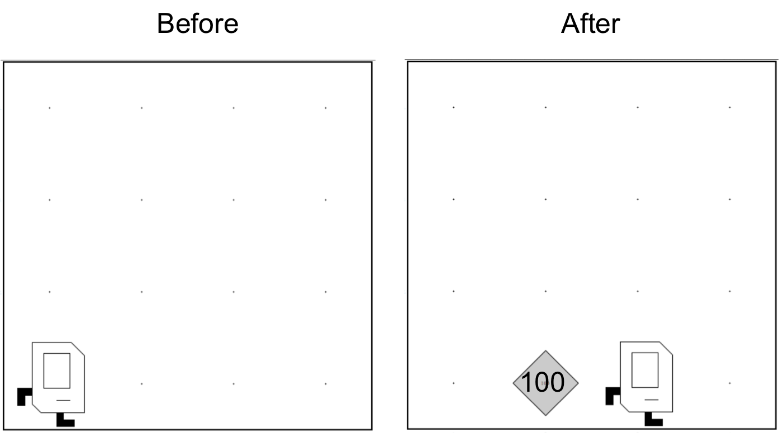
Place 99 beepers?
99

Slide 27
Place 99 beepers
public class Place99Beepers extends SuperKarel {
public void run() {
move();
for(int i = 0; i < 99; i++) {
putBeeper();
}
move();
}
}
This “for loop” repeats the code in its “body” 99 times

Slide 28

Place Beeper Square
public class BeeperSquare extends SuperKarel {
public void run() {
for(int i = 0; i < 4; i++) {
putBeeper();
move();
turnLeft();
}
}
}

Slide 29
Place Beeper Square
public class BeeperSquare extends SuperKarel {
public void run() {
for(int i = 0; i < 4; i++) {
putBeeper();
move();
turnLeft();
}
}
}

Slide 30
Place Beeper Square
public class BeeperSquare extends SuperKarel {
public void run() {
for(int i = 0; i < 4; i++) {
putBeeper();
move();
turnLeft();
}
}
}
First time through the loop

Slide 31

Place Beeper Square
public class BeeperSquare extends SuperKarel {
public void run() {
for(int i = 0; i < 4; i++) {
putBeeper();
move();
turnLeft();
}
}
}
First time through the loop

Slide 32
Place Beeper Square
public class BeeperSquare extends SuperKarel {
public void run() {
for(int i = 0; i < 4; i++) {
putBeeper();
move();
turnLeft();
}
}
}
First time through the loop

Slide 33
Place Beeper Square
public class BeeperSquare extends SuperKarel {
public void run() {
for(int i = 0; i < 4; i++) {
putBeeper();
move();
turnLeft();
}
}
}
First time through the loop

Slide 34
Place Beeper Square
public class BeeperSquare extends SuperKarel {
public void run() {
for(int i = 0; i < 4; i++) {
putBeeper();
move();
turnLeft();
}
}
}
Second time through the loop

Slide 35
Place Beeper Square
public class BeeperSquare extends SuperKarel {
public void run() {
for(int i = 0; i < 4; i++) {
putBeeper();
move();
turnLeft();
}
}
}
Second time through the loop

Slide 36
Place Beeper Square
public class BeeperSquare extends SuperKarel {
public void run() {
for(int i = 0; i < 4; i++) {
putBeeper();
move();
turnLeft();
}
}
}
Second time through the loop

Slide 37
Place Beeper Square
public class BeeperSquare extends SuperKarel {
public void run() {
for(int i = 0; i < 4; i++) {
putBeeper();
move();
turnLeft();
}
}
}
Second time through the loop

Slide 38
Place Beeper Square
public class BeeperSquare extends SuperKarel {
public void run() {
for(int i = 0; i < 4; i++) {
putBeeper();
move();
turnLeft();
}
}
}
Third time through the loop

Slide 39
Place Beeper Square
public class BeeperSquare extends SuperKarel {
public void run() {
for(int i = 0; i < 4; i++) {
putBeeper();
move();
turnLeft();
}
}
}
Third time through the loop

Slide 40
Place Beeper Square
public class BeeperSquare extends SuperKarel {
public void run() {
for(int i = 0; i < 4; i++) {
putBeeper();
move();
turnLeft();
}
}
}
Third time through the loop

Slide 41
Place Beeper Square
public class BeeperSquare extends SuperKarel {
public void run() {
for(int i = 0; i < 4; i++) {
putBeeper();
move();
turnLeft();
}
}
}
Third time through the loop

Slide 42
Place Beeper Square
public class BeeperSquare extends SuperKarel {
public void run() {
for(int i = 0; i < 4; i++) {
putBeeper();
move();
turnLeft();
}
}
}
Fourth time through the loop

Slide 43
Place Beeper Square
public class BeeperSquare extends SuperKarel {
public void run() {
for(int i = 0; i < 4; i++) {
putBeeper();
move();
turnLeft();
}
}
}
Fourth time through the loop

Slide 44
Place Beeper Square
public class BeeperSquare extends SuperKarel {
public void run() {
for(int i = 0; i < 4; i++) {
putBeeper();
move();
turnLeft();
}
}
}
Fourth time through the loop

Slide 45
Place Beeper Square
public class BeeperSquare extends SuperKarel {
public void run() {
for(int i = 0; i < 4; i++) {
putBeeper();
move();
turnLeft();
}
}
}
Fourth time through the loop

Slide 46
Place Beeper Square
public class BeeperSquare extends SuperKarel {
public void run() {
for(int i = 0; i < 4; i++) {
putBeeper();
move();
turnLeft();
}
}
}

Slide 47
Exciting!

Slide 48

Aside: Super Karel
public class BeeperSquare extends SuperKarel {
public void run() {
for(int i = 0; i < 4; i++) {
putBeeper();
move();
turnLeft();
}
}
}

Slide 49
Aside: Super Karel
public class BeeperSquare extends SuperKarel {
public void run() {
// super karel has a few more commands
turnRight();
turnAround();
paintCorner(BLUE);
putBeeper();
move();
}
}

Slide 50
Next task

Slide 51
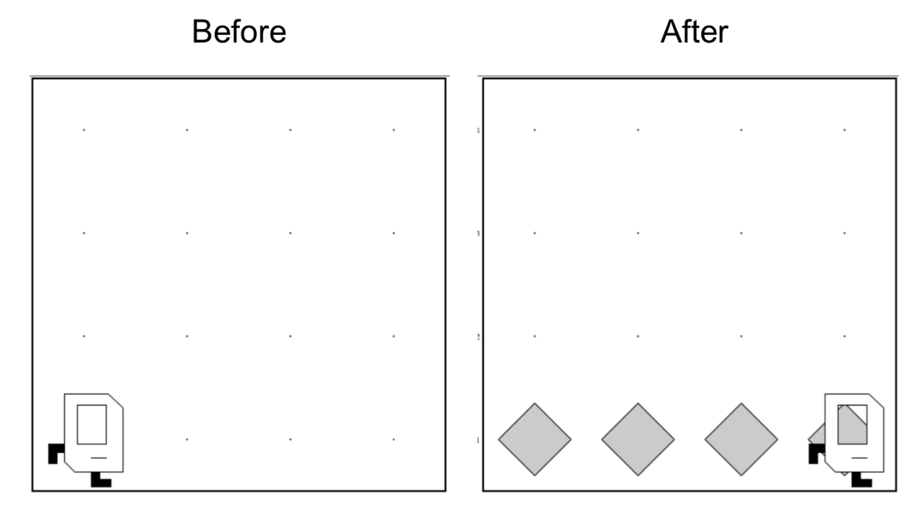
Place Beeper Line
Try and solve it!

Slide 52
Place Beeper Line
import stanford.karel.*;
public class BeeperLine extends SuperKarel {
public void run() {
for(int i = 0; i < 4; i++) {
putBeeper();
move();
}
}
}

Slide 53


Slide 54

Place Beeper Line
import stanford.karel.*;
public class BeeperLine extends SuperKarel {
public void run() {
for(int i = 0; i < 4; i++) {
putBeeper();
move();
}
}
}

Slide 55


Slide 56

Place Beeper Line
import stanford.karel.*;
public class BeeperLine extends SuperKarel {
public void run() {
for(int i = 0; i < 4; i++) {
putBeeper();
move();
}
}
}
What we want

Slide 57
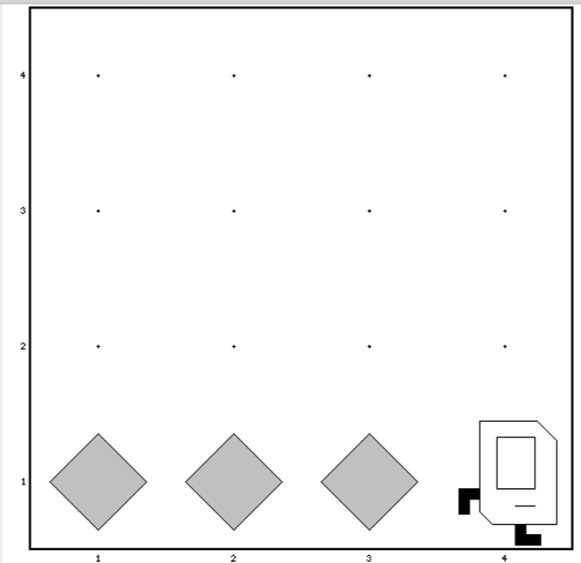
Place Beeper Line
import stanford.karel.*;
public class BeeperLine extends SuperKarel {
public void run() {
for(int i = 0; i < 3; i++) {
putBeeper();
move();
}
}
}

Slide 58

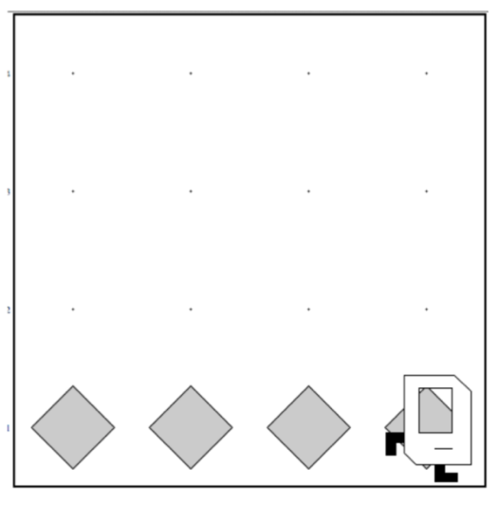
Place Beeper Line
import stanford.karel.*;
public class BeeperLine extends SuperKarel {
public void run() {
for(int i = 0; i < 3; i++) {
putBeeper();
move();
}
// extra put beeper
putBeeper();
}
}

Slide 59
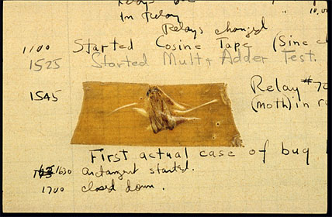
Actual Bug from Mark II Computer
Actual Bug from Marc II

Slide 60
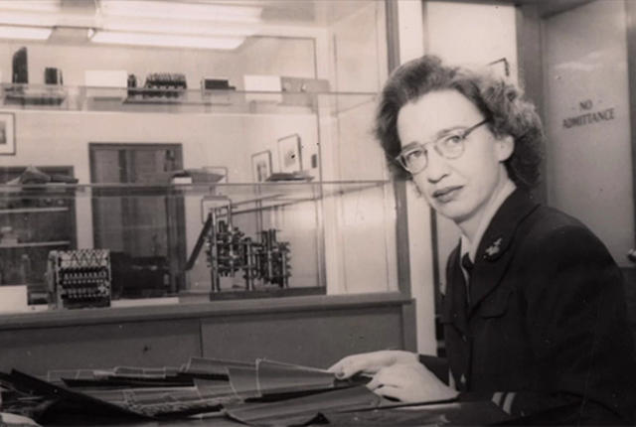
Grace Hopper

Slide 61
Fence Post Problem
* Also sometimes called an Off By One Error

Slide 62
Unstoppable

Slide 63
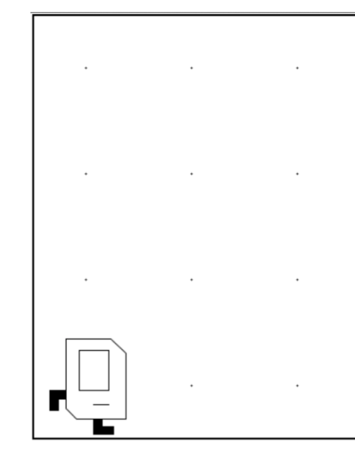
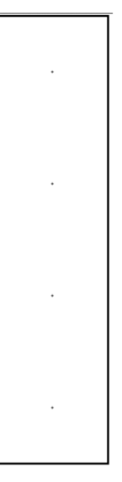
Don’t Know World Size
?

Slide 64
While Loop

Slide 65
While Loop
import stanford.karel.*;
public class BeeperLine extends SuperKarel {
public void run() {
// example while loop
while(condition) {
code to repeat
}
}
}

Slide 66
Possible Conditions
Test | Opposite | What it checks
frontIsClear() | frontIsBlocked() | Is there a wall in front of Karel?
leftIsClear() | leftIsBlocked() | Is there a wall to Karel’s left?
rightIsClear() | rightIsBlocked() | Is there a wall to Karel’s right?
beepersPresent() | noBeepersPresent() | Are there beepers on this corner?
beepersInBag() | noBeepersInBag() | Any there beepers in Karel’s bag?
facingNorth() | notFacingNorth() | Is Karel facing north?
facingEast() | notFacingEast() | Is Karel facing east?
facingSouth() | notFacingSouth() | Is Karel facing south?
facingWest() | notFacingWest() | Is Karel facing west?
This is Table 1 on page 18 of the Karel coursereader.

Slide 67
Move to Wall
import stanford.karel.*;
public class BeeperLine extends SuperKarel {
public void run() {
// example while loop
while(condition) {
code to repeat
}
}
}

Slide 68
Move to Wall
import stanford.karel.*;
public class BeeperLine extends SuperKarel {
public void run() {
// example while loop
while(frontIsClear()) {
code to repeat
}
}
}

Slide 69
Move to Wall
import stanford.karel.*;
public class BeeperLine extends SuperKarel {
public void run() {
// example while loop
while(frontIsClear()) {
move();
}
}
}

Slide 70
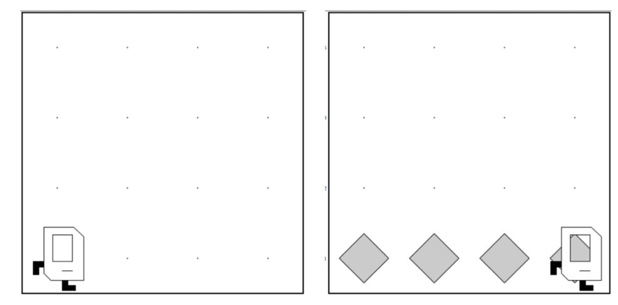
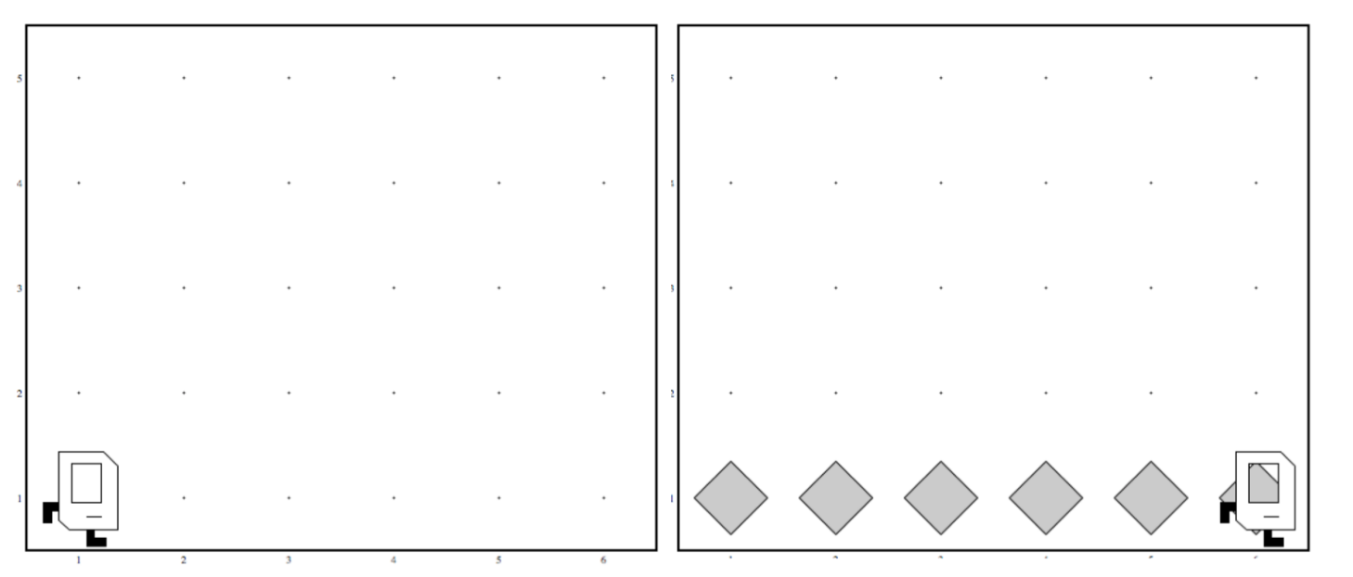
Code that Works in Any World
Before
After
Before
After

Slide 71
Place Beeper Line
import stanford.karel.*;
public class BeeperLine extends SuperKarel {
public void run() {
// example while loop
while(frontIsClear()) {
move();
}
}
}

Slide 72
Place Beeper Line
import stanford.karel.*;
public class BeeperLine extends SuperKarel {
public void run() {
// example while loop
while(frontIsClear()) {
putBeeper();
move();
}
}
}

Slide 73
Place Beeper Line
import stanford.karel.*;
public class BeeperLine extends SuperKarel {
public void run() {
// example while loop
while(frontIsClear()) {
putBeeper();
move();
}
// extra put beeper
putBeeper();
}
}

Slide 74
Place Beeper Line
import stanford.karel.*;
public class BeeperLine extends SuperKarel {
public void run() {
// example while loop
while(frontIsClear()) {
putBeeper();
move();
}
// extra put beeper
putBeeper();
}
}

Slide 75
Place Beeper Line
import stanford.karel.*;
public class BeeperLine extends SuperKarel {
public void run() {
// example while loop
while(frontIsClear()) {
putBeeper();
move();
}
// extra put beeper
putBeeper();
}
}

Slide 76
Place Beeper Line
import stanford.karel.*;
public class BeeperLine extends SuperKarel {
public void run() {
// example while loop
while(frontIsClear()) {
putBeeper();
move();
}
// extra put beeper
putBeeper();
}
}

Slide 77
Place Beeper Line
import stanford.karel.*;
public class BeeperLine extends SuperKarel {
public void run() {
// example while loop
while(frontIsClear()) {
putBeeper();
move();
}
// extra put beeper
putBeeper();
}
}

Slide 78
Place Beeper Line
import stanford.karel.*;
public class BeeperLine extends SuperKarel {
public void run() {
// example while loop
while(frontIsClear()) {
putBeeper();
move();
}
// extra put beeper
putBeeper();
}
}

Slide 79
Place Beeper Line
import stanford.karel.*;
public class BeeperLine extends SuperKarel {
public void run() {
// example while loop
while(frontIsClear()) {
putBeeper();
move();
}
// extra put beeper
putBeeper();
}
}

Slide 80
Place Beeper Line
import stanford.karel.*;
public class BeeperLine extends SuperKarel {
public void run() {
// example while loop
while(frontIsClear()) {
putBeeper();
move();
}
// extra put beeper
putBeeper();
}
}

Slide 81
Place Beeper Line
import stanford.karel.*;
public class BeeperLine extends SuperKarel {
public void run() {
// example while loop
while(frontIsClear()) {
putBeeper();
move();
}
// extra put beeper
putBeeper();
}
}

Slide 82
Place Beeper Line
import stanford.karel.*;
public class BeeperLine extends SuperKarel {
public void run() {
// example while loop
while(frontIsClear()) {
putBeeper();
move();
}
// extra put beeper
putBeeper();
}
}

Slide 83
Place Beeper Line
import stanford.karel.*;
public class BeeperLine extends SuperKarel {
public void run() {
// example while loop
while(frontIsClear()) {
putBeeper();
move();
}
// extra put beeper
putBeeper();
}
}

Slide 84
Place Beeper Line
import stanford.karel.*;
public class BeeperLine extends SuperKarel {
public void run() {
// example while loop
while(frontIsClear()) {
putBeeper();
move();
}
// extra put beeper
putBeeper();
}
}

Slide 85
Place Beeper Line
import stanford.karel.*;
public class BeeperLine extends SuperKarel {
public void run() {
// example while loop
while(frontIsClear()) {
putBeeper();
move();
}
// extra put beeper
putBeeper();
}
}

Slide 86
Place Beeper Line
import stanford.karel.*;
public class BeeperLine extends SuperKarel {
public void run() {
// example while loop
while(frontIsClear()) {
putBeeper();
move();
}
// extra put beeper
putBeeper();
}
}

Slide 88
Common misconception:

Slide 89
Place Beeper Line: Redux
import stanford.karel.*;
public class BeeperLine extends SuperKarel {
public void run() {
// place a first beeper
putBeeper();
// example while loop
while(frontIsClear()) {
move();
putBeeper();
}
}
}

Slide 90
Place Beeper Line: Redux
import stanford.karel.*;
public class BeeperLine extends SuperKarel {
public void run() {
// place a first beeper
putBeeper();
// example while loop
while(frontIsClear()) {
move();
putBeeper();
}
}
}

Slide 91
Place Beeper Line: Redux
import stanford.karel.*;
public class BeeperLine extends SuperKarel {
public void run() {
// place a first beeper
putBeeper();
// example while loop
while(frontIsClear()) {
move();
putBeeper();
}
}
}

Slide 92
Place Beeper Line: Redux
import stanford.karel.*;
public class BeeperLine extends SuperKarel {
public void run() {
// place a first beeper
putBeeper();
// example while loop
while(frontIsClear()) {
move();
putBeeper();
}
}
}

Slide 93
Place Beeper Line: Redux
import stanford.karel.*;
public class BeeperLine extends SuperKarel {
public void run() {
// place a first beeper
putBeeper();
// example while loop
while(frontIsClear()) {
move();
putBeeper();
}
}
}

Slide 94
Place Beeper Line: Redux
import stanford.karel.*;
public class BeeperLine extends SuperKarel {
public void run() {
// place a first beeper
putBeeper();
// example while loop
while(frontIsClear()) {
move();
putBeeper();
}
}
}

Slide 95
Place Beeper Line: Redux
import stanford.karel.*;
public class BeeperLine extends SuperKarel {
public void run() {
// place a first beeper
putBeeper();
// example while loop
while(frontIsClear()) {
move();
putBeeper();
}
}
}

Slide 96
Place Beeper Line: Redux
import stanford.karel.*;
public class BeeperLine extends SuperKarel {
public void run() {
// place a first beeper
putBeeper();
// example while loop
while(frontIsClear()) {
move();
putBeeper();
}
}
}
This is incredibly important!

Slide 97
Place Beeper Line: Redux
import stanford.karel.*;
public class BeeperLine extends SuperKarel {
public void run() {
// place a first beeper
putBeeper();
// example while loop
while(frontIsClear()) {
move();
putBeeper();
}
}
}

Slide 98
Place Beeper Line: Redux
import stanford.karel.*;
public class BeeperLine extends SuperKarel {
public void run() {
// place a first beeper
putBeeper();
// example while loop
while(frontIsClear()) {
move();
putBeeper();
}
}
}

Slide 99
Place Beeper Line: Redux
import stanford.karel.*;
public class BeeperLine extends SuperKarel {
public void run() {
// place a first beeper
putBeeper();
// example while loop
while(frontIsClear()) {
move();
putBeeper();
}
}
}

Slide 100
Place Beeper Line: Redux
import stanford.karel.*;
public class BeeperLine extends SuperKarel {
public void run() {
// place a first beeper
putBeeper();
// example while loop
while(frontIsClear()) {
move();
putBeeper();
}
}
}

Slide 101
Place Beeper Line: Redux
import stanford.karel.*;
public class BeeperLine extends SuperKarel {
public void run() {
// place a first beeper
putBeeper();
// example while loop
while(frontIsClear()) {
move();
putBeeper();
}
}
}

Slide 102
A program executes one line at a time.
The while loop checks its condition only at the start of the code block and before repeating.

Slide 103
Which Loop
Repeat Process
Know how many times
Don’t know how many times
For Loop
While Loop

Slide 104
What if you only want to repeat one time?

Slide 105
If statement

Slide 106
If Statement
import stanford.karel.*;
public class IfExample extends SuperKarel {
public void run() {
// example of an if statement
if(condition) {
code to run if condition is true
}
}
}

Slide 107
If Statement
import stanford.karel.*;
public class IfExample extends Pretend{
public void run() {
// example of an if statement
if(youLikeBeyonce()) {
makeSomeNoise();
}
}
}

Slide 108
If Statement
import stanford.karel.*;
public class IfExample extends SuperKarel{
public void run() {
safeMove();
}
private void safeMove() {
if(frontIsClear()) {
move();
}
}
}

Slide 109
If / Else Statement
import stanford.karel.*;
public class IfExample extends SuperKarel{
public void run() {
invertBeeper();
}
private void invertBeeper() {
if(beepersPresent()) {
pickBeeper();
} else {
putBeeper();
}
}
}

Slide 110
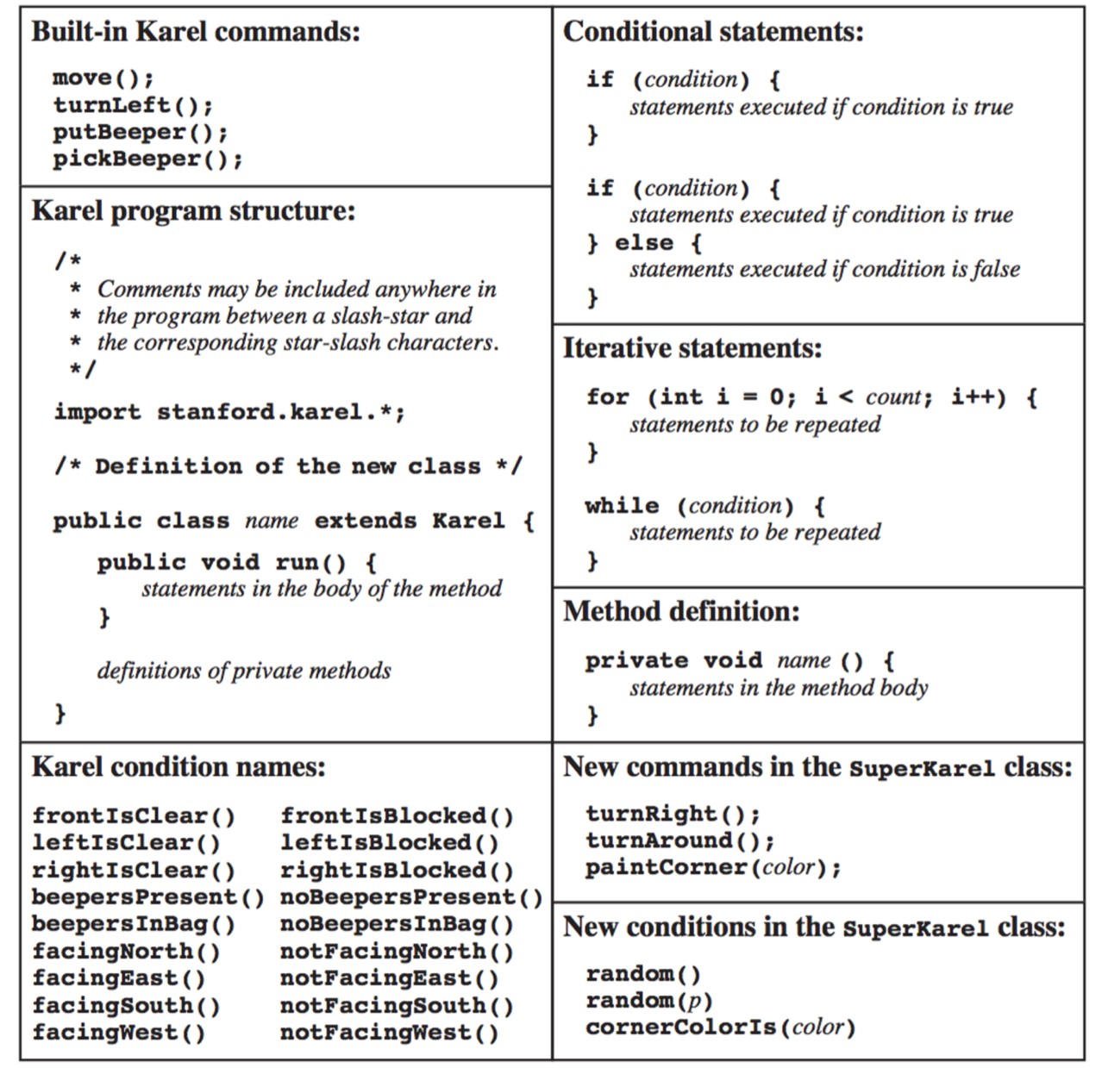
The Full Karel

Slide 111
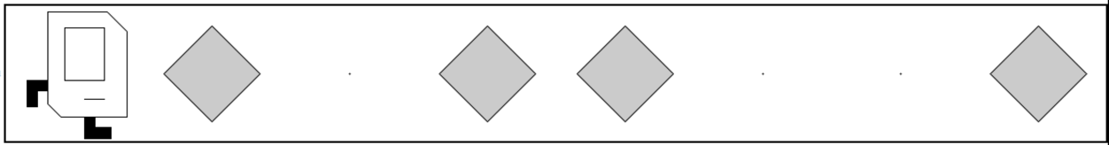
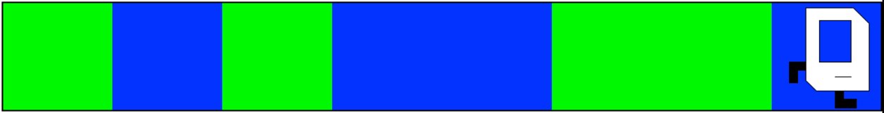
Random Painter
Before:
After:
Before:
After:

Slide 112
You just learned most of programming “control flow”

Slide 113
Today’s Goal
Code using loops and conditions
Trace programs that use loops and conditions

Slide 114
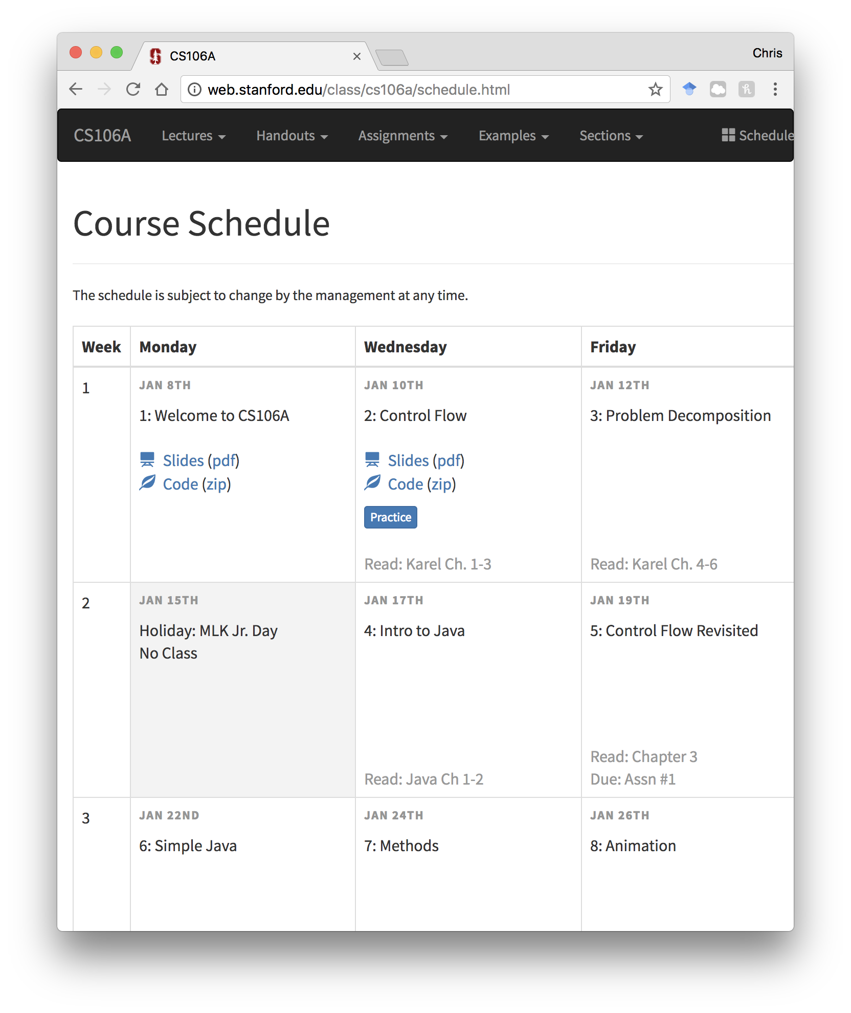
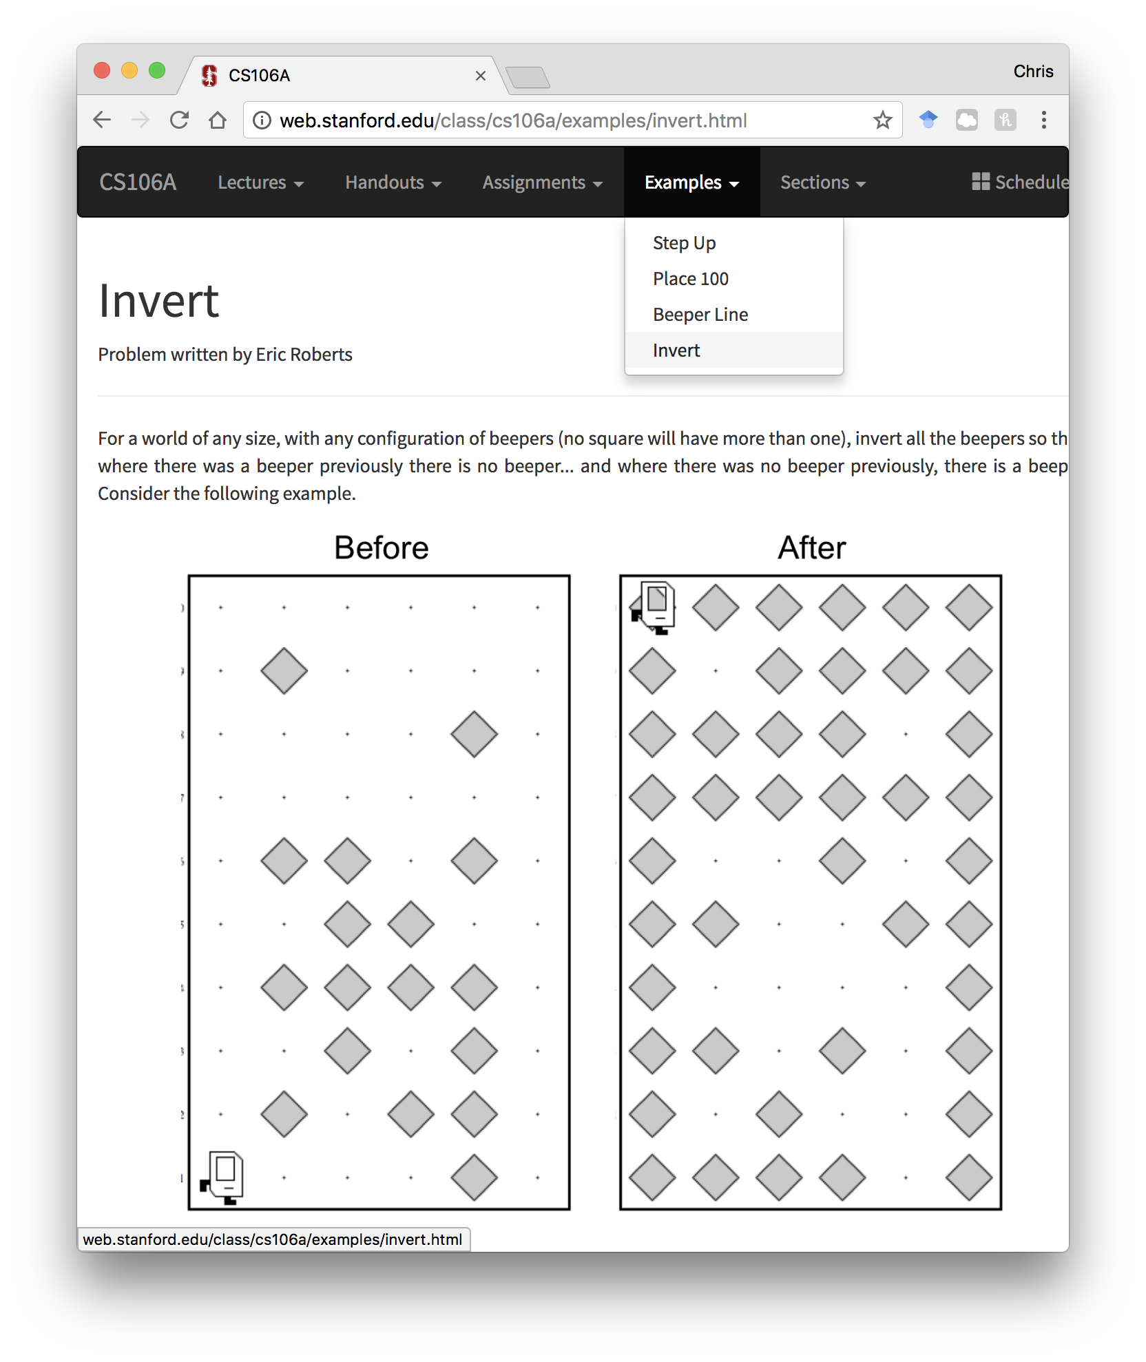
Examples and Practice

Slide 115
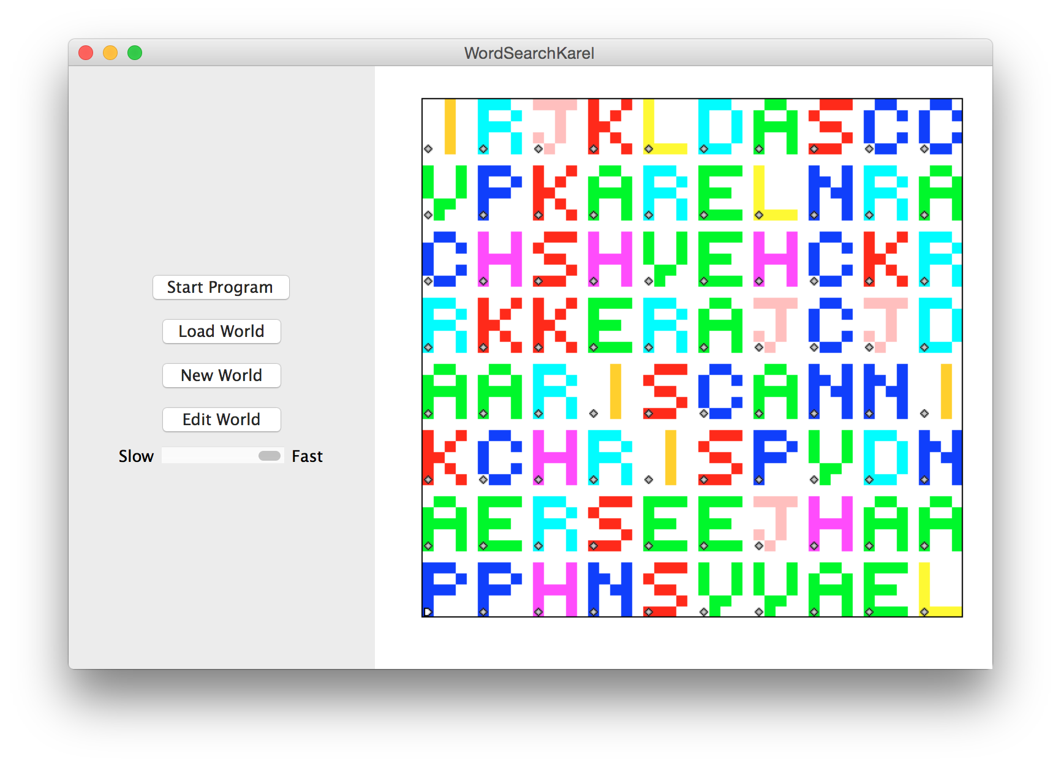

Slide 116
